Slide 1
Sequence-to-Sequence Text Generation for Hinglish Auto-Completion using Recurrent Neural Networks
Presented By- Chetan Choudhary, Mukund Dhar and Jitesh Parapoil

Slide 2
Intelligent Hinglish Text Auto-Completion
In today's digital age, effortless communication is key, and Hinglish – the blend of Hindi and English languages – has become a widespread means of expression, especially in urban India.
Our project aims to develop an innovative auto-completion system that can intelligently suggest relevant words or phrases in Hinglish, making text entry more efficient and intuitive for millions of users.
While existing text auto-completion systems have utilized Recurrent Neural Networks (RNNs) for languages like English, our focus is on tackling the unique challenges of Hinglish, a language that seamlessly combines two distinct linguistic structures.

Slide 3
Goals
Leverage Hinglish Datasets: We have curated diverse Hinglish text datasets from social media, online forums, and other relevant sources, capturing the nuances of this language fusion.
Adapt RNNs for Hinglish: By training advanced RNN models on these datasets, our system will learn the patterns and context-specific word relationships in Hinglish, enabling accurate and relevant auto-completion suggestions.
Enhance User Experience: Our ultimate goal is to provide a seamless and intuitive text entry experience for Hinglish users, saving time and effort while facilitating effective communication.
Explore Novel Techniques: We will investigate innovative techniques to handle the complexities of Hinglish, such as code-switching and language mixing, ensuring our system stays at the forefront of this emerging field.

Slide 4
Current Approaches and Their Shortcomings
Text auto-completion is typically done using language models trained on large text corpora. While existing approaches have shown promising results for languages like English, they have not specifically addressed the unique challenges posed by Hinglish – a complex blend of Hindi and English.
Some notable related works and their shortcomings are:
LSTM-based Next Word Prediction (Kulkarni et al., 2022):
Approach: Uses an LSTM (Long Short-Term Memory) network to predict the next word based on the previous sequence of words.
Shortcoming: Trained on English text data, does not cater to the intricate semantics and code-switching patterns of Hinglish.
Transformer-based Language Model (Lewis et al., 2019):
Approach: BART (Bidirectional and Auto-Regressive Transformers) pre-trained on large English corpora for sequence-to-sequence tasks, including text generation.
Shortcoming: While powerful, these models are primarily trained on English data, which may not generalize well to the unique characteristics of Hinglish.
RNN-based Next Words Prediction (Ambulgekar et al., 2021):
Approach: Utilizes RNNs (Recurrent Neural Networks) to predict the next few words based on the input sequence.
Shortcoming: Trained on English data, lacks the ability to capture the nuances of Hinglish, such as code-switching and language mixing, potentially leading to inaccurate or irrelevant suggestions.

Slide 5
Handling Hinglish Complexity
Unique Challenge:
Hinglish presents a distinct linguistic challenge due to its fusion of Hindi and English vocabulary, grammar, and syntax.
By training our models on a diverse corpus of Hinglish text, we aim to develop a deep understanding of the language's intricacies, enabling more accurate auto-completion suggestions.
Innovative Approach:
We will leverage the flexibility and adaptability of LSTM, GRU, and Vanilla RNN architectures to effectively model the intricacies of Hinglish.
By training our models on a diverse corpus of Hinglish text, we aim to develop a deep understanding of the language's intricacies, enabling more accurate auto-completion suggestions.

Slide 6
Differences from Existing Methods
Hinglish Focus: Unlike existing methods tailored for English, our approach centers specifically on addressing the challenges posed by Hinglish—a dynamic blend of Hindi and English. By acknowledging and accommodating the linguistic intricacies of Hinglish, our model is primed to deliver more accurate and contextually relevant auto-completion suggestions.
Adaptability to Diverse Styles: Recognizing the diversity of writing styles and expressions within Hinglish, our approach prioritizes adaptability. Through extensive experimentation with different architectures and meticulous fine-tuning of parameters, our model adeptly adjusts to varying linguistic nuances, ensuring optimal performance across a spectrum of contexts.

Slide 7
Why our Approach will succeed
Targeted Focus: By specifically addressing the challenges posed by Hinglish, our approach fills a critical gap in the existing literature on auto-completion. Rather than applying generic models designed for English to Hinglish data, we tailor our methods to the unique linguistic characteristics of Hinglish, increasing the likelihood of success in real-world applications.
Innovative Methodologies: Through the strategic experimentation with LSTM, GRU, and Vanilla RNNs, we harness the power of state-of-the-art neural network architectures to tackle the complexities of Hinglish auto-completion.

Slide 8
What are the challenges?
Gathering a large and diverse dataset
A large corpus would be required for the task at hand
Selecting appropriate RNN architecture
Building the appropriate architecture
Training the model
Training the model on large datasets considering computational resources
Exception Handling
Developing robust mechanisms for handling out-of-vocabulary words and rare word combinations

Slide 9
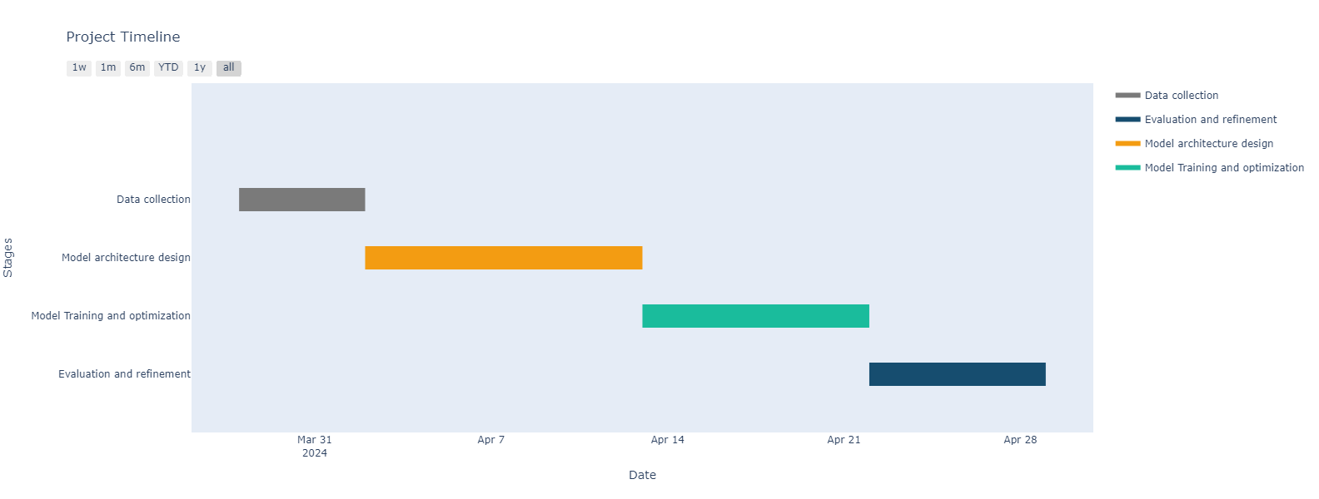
How long will it take?

Slide 10
How do you evaluate your approach?
Evaluation Metrics :
Perplexity: A measure of how well the model predicts the next word/sequence
Accuracy: Percentage of correct next word/phrase predictions
Human Feedback : Manual checking if the generated words are of the same context and they make sense.

Slide 11
How do you evaluate your approach?
Evaluation Strategies :
Split the dataset into training, validation, and test sets
Evaluate the model's performance on the held-out test set
Conduct human evaluation by having users interact with the system and provide feedback
Compare performance with existing auto-completion systems or baselines

